Slide 1
HTML Audio and Video & Drag and Drop

Slide 2
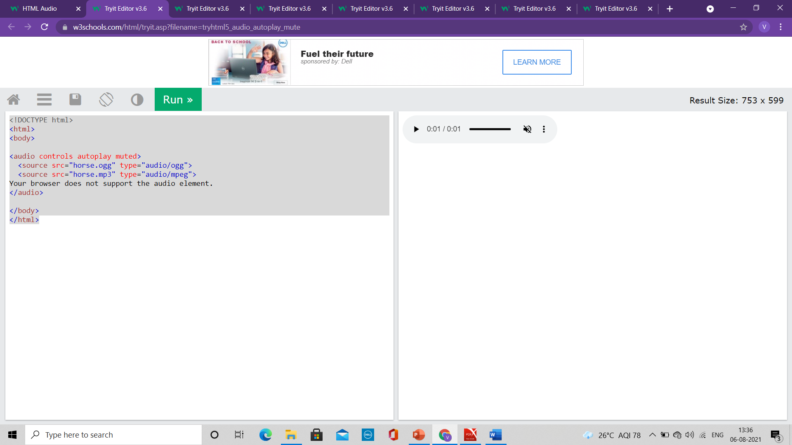
HTML Audio
<!DOCTYPE html> <html lang = "en-US"> <head> <title>Images</title> </head> <body>
<audio controls autoplay muted> <source src="horse.ogg" type="audio/ogg"> <source src="horse.mp3" type="audio/mpeg"> Your browser does not support the audio element. </audio>
</body>
</html>

Slide 3
HTML Audio
<!DOCTYPE html> <html lang = "en-US"> <head> <title>Images</title> </head> <body>
<audio controls autoplay muted> <source src="horse.ogg" type="audio/ogg"> <source src="horse.mp3" type="audio/mpeg"> Your browser does not support the audio element. </audio>
</body>
</html>
HTML Audio - Media Types
File Format Media Type
MP3 audio/mpeg
OGG audio/ogg
WAV audio/wav

Slide 4
HTML Video
The HTML <video> element is used to show a video on a web page.
The controls attribute adds video controls, like play, pause, and volume.
It is a good idea to always include width and height attributes.
If height and width are not set, the page might flicker while the video loads.
The <source> element allows you to specify alternative video files which the browser may choose from.
The browser will use the first recognized format.
The text between the <video> and </video> tags will only be displayed in browsers that do not support the <video> element.
Add muted after autoplay to let your video start playing automatically (but muted)

Slide 5
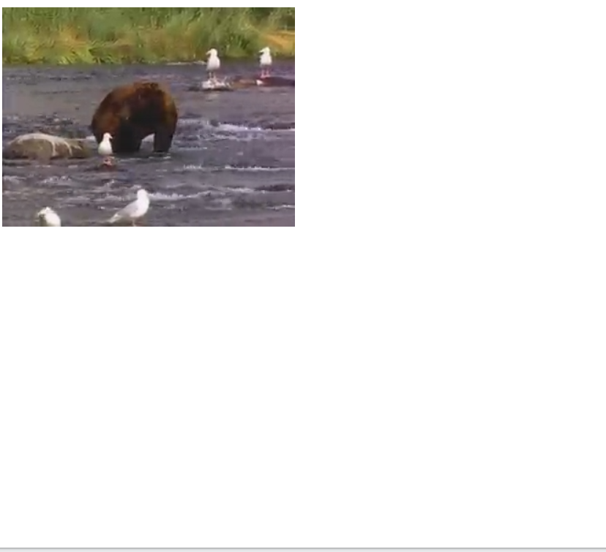
HTML Video
<!DOCTYPE html> <html lang = "en-US"> <head> <title>Images</title> </head> <body>
<video width="320" height="240" autoplay muted> <source src="movie.mp4" type="video/mp4"> <source src="movie.ogg" type="video/ogg"> Your browser does not support the video tag. </video>
</body>
</html>

Slide 6
HTML Video
<!DOCTYPE html> <html lang = "en-US"> <head> <title>Images</title> </head> <body>
<video width="320" height="240" autoplay muted> <source src="movie.mp4" type="video/mp4"> <source src="movie.ogg" type="video/ogg"> Your browser does not support the video tag. </video>
</body>
</html>
HTML Video - Media Types
File Format Media Type
MP4 video/mp4
WebM video/webm
Ogg video/ogg

Slide 7
HTML Video
HTML Video - Methods, Properties, and Events
The HTML DOM defines methods, properties, and events for the <video> element.
This allows you to load, play, and pause videos, as well as setting duration and volume.
There are also DOM events that can notify you when a video begins to play, is paused, etc.

Slide 8
HTML Audio/Video Methods
Method Description
addTextTrack() Adds a new text track to the audio/video
canPlayType() Checks if the browser can play the specified audio/video type
load() Re-loads the audio/video element
play() Starts playing the audio/video
pause() Pauses the currently playing audio/vide

Slide 9
HTML Drag and Drop
In HTML, any element can be dragged and dropped.
Drag and drop is a very common feature. It is when you "grab" an object and drag it to a different location.
The numbers in the following table specify the first browser version that fully supports Drag and Drop.

Slide 10
HTML Drag and Drop
Make an Element Draggable
To make an element draggable, set the draggable attribute to true:
<img draggable="true">
What to Drag - ondragstart and setData()
1) Specify what should happen when the element is dragged.
2) ondragstart attribute calls a function, drag(event), that specifies what data to be dragged.
3) The dataTransfer.setData() method sets the data type and the value of the dragged data:
function drag(ev) {
ev.dataTransfer.setData("text", ev.target.id);
}
In this case, the data type is "text" and the value is the id of the draggable element ("drag1").

Slide 11
HTML Drag and Drop
Where to Drop - ondragover
The ondragover event specifies where the dragged data can be dropped.
By default, data/elements cannot be dropped in other elements.
To allow a drop, we must prevent the default handling of the element.
This is done by calling the event.preventDefault() method for the ondragover event:
event.preventDefault()

Slide 12
HTML Drag and Drop
Do the Drop - ondrop
When the dragged data is dropped, a drop event occurs. In the next example, the ondrop attribute calls a function, drop(event):
function drop(ev)
{
ev.preventDefault();
var data = ev.dataTransfer.getData("text");
ev.target.appendChild(document.getElementById(data));
}

Slide 13
HTML Drag and Drop
<!DOCTYPE HTML> <html> <head> <script> function allowDrop(ev) { ev.preventDefault(); } function drag(ev) { ev.dataTransfer.setData("text", ev.target.id); } function drop(ev) { ev.preventDefault(); var data = ev.dataTransfer.getData("text"); ev.target.appendChild(document.getElementById(data)); } </script> </head> <body> <div id="div1" ondrop="drop(event)" ondragover="allowDrop(event)"></div> <img id="drag1" src="img_logo.gif" draggable="true" ondragstart="drag(event)" width="336" height="69"> </body>
Explanation of Code:
Call preventDefault() to prevent the browser default handling of the data (default is open as link on drop)
Get the dragged data with the dataTransfer.getData() method.
This method will return any data that was set to the same type in the setData() method
The dragged data is the id of the dragged element ("drag1")
Append the dragged element into the drop element

